Slide 1
The Waterfall model
Requirements
Software Requirement Specifications
Design
Design documents
Implementation
Software under test
Testing
Final software

Slide 2
The Waterfall model
Requirements
Working in silos
The process is sequential
Change is costly
Delays can lead to low quality
Building the right thing?
Design
Implementation
Testing

Slide 3
Agile Software Development
“An umbrella term for a set of frameworks and practices based on the values and principles expressed in the Manifesto for Agile Software Development and the 12 Principles behind it”
Scrum, Extreme Programming, Kanban, BDD, etc.

Slide 4
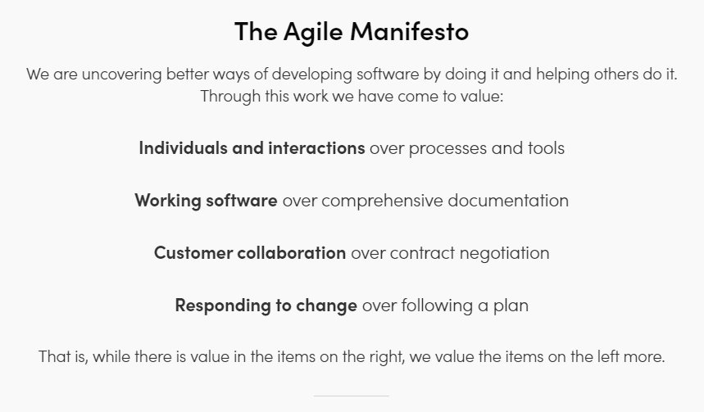
Agile Software Development

Slide 5
Where Agile Fall Short
Testing still follows traditional model
Analyze
Plan
Analyze
Plan
Analyze
Plan
Design
Build
Test
Design
Build
Test
Design
Build
Test
Deploy
Deploy
Deploy

Slide 6
Where Agile Fall Short
Testing still follows traditional model
Testing happens in the end
Design
Build
Test
Analyze
Plan
Deploy
Design
Build
Test
Analyze
Plan
Deploy
Design
Build
Test
Analyze
Plan
Deploy

Slide 7
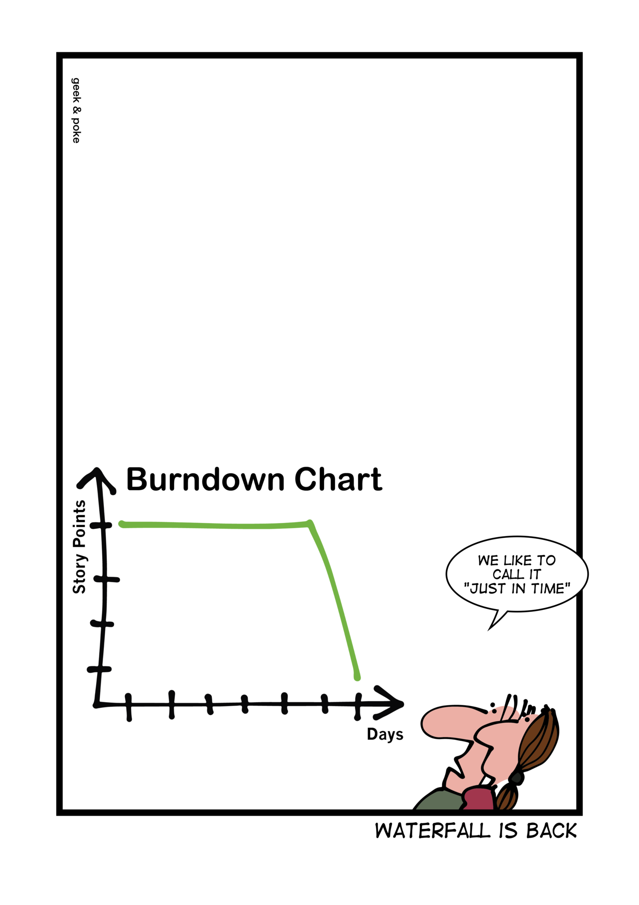
Where Agile Fall Short
Testing still follows traditional model
Tech debt

Slide 8
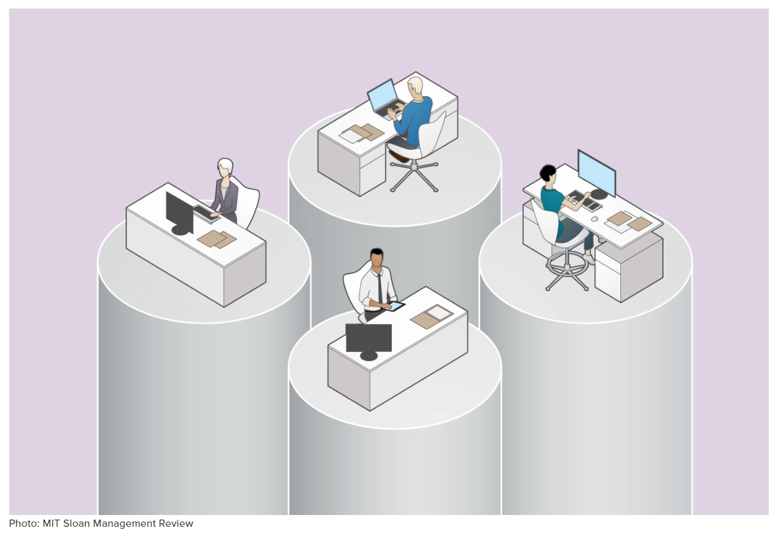
Where Agile Fall Short
Lack of collaboration

Slide 9
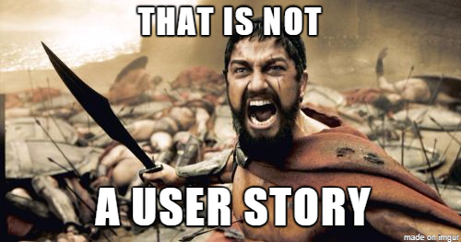
Where Agile Fall Short
User stories not clear

Slide 10
Where Agile Fall Short
Safety net
Regression
Design
Build
Test
Analyze
Plan
Commit
Design
Build
Test
Analyze
Plan
Commit
Design
Build
Test
Analyze
Plan
Commit

Slide 11
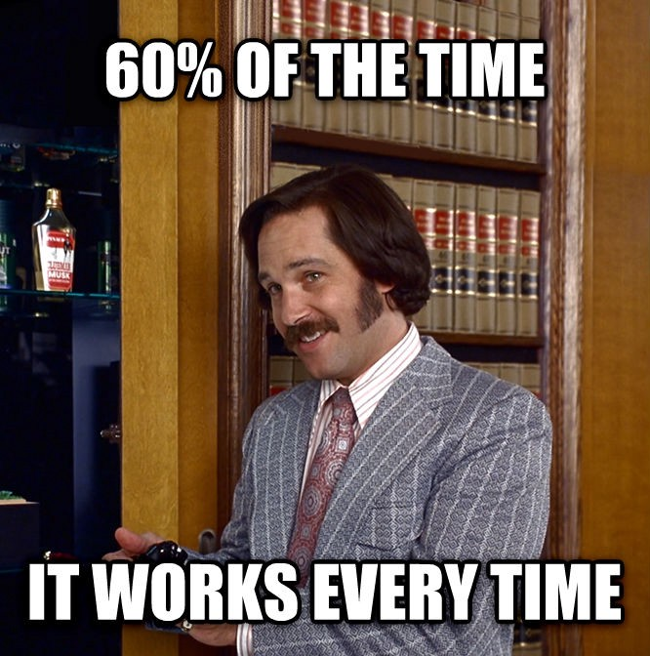
Where Agile Fall Short
Bad automation

Slide 12
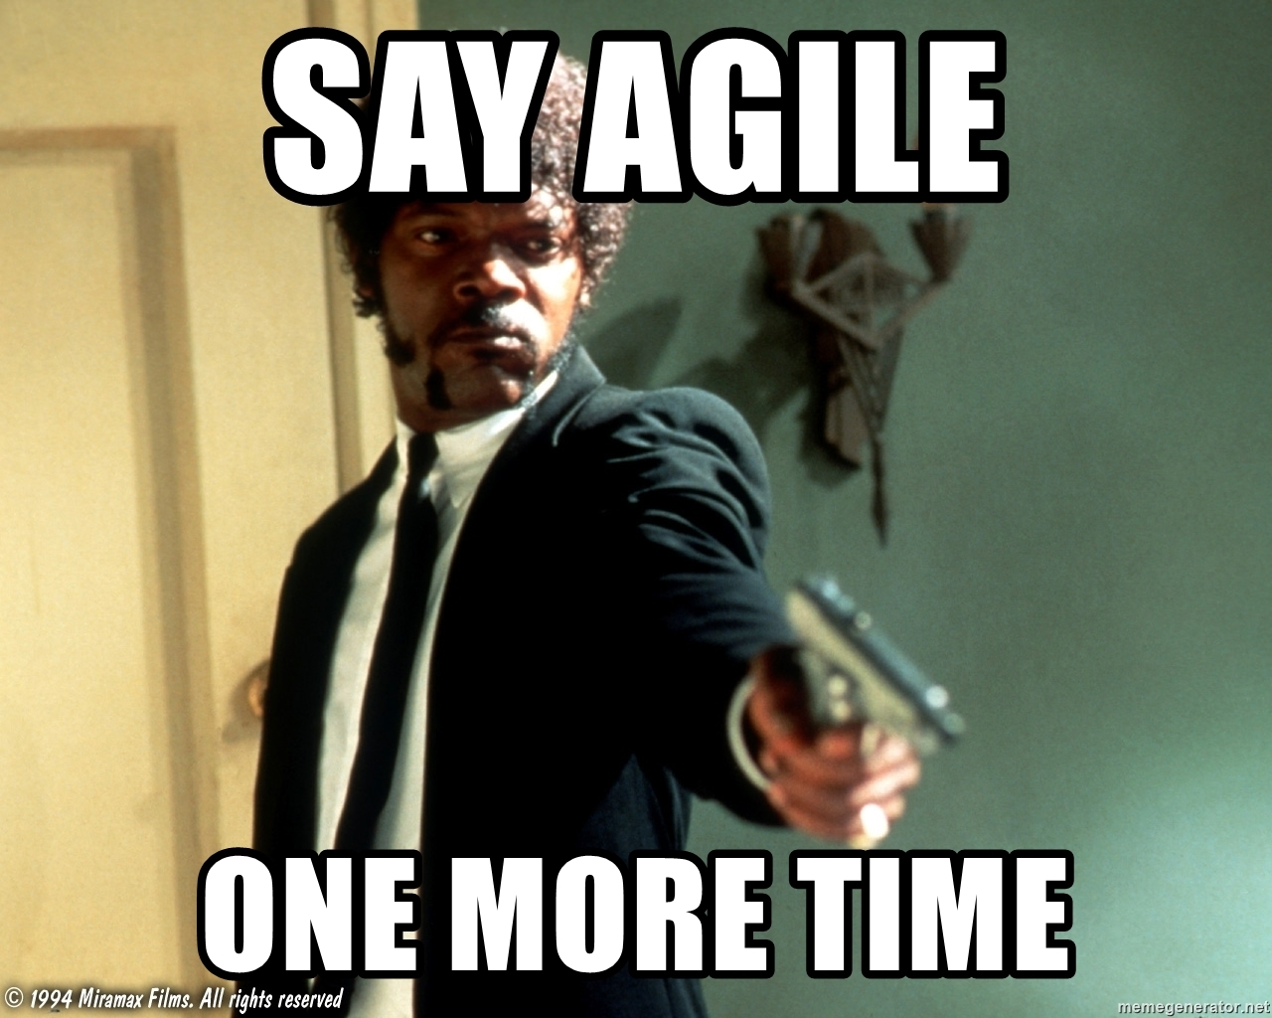
Where Agile Fall Short

Slide 13
Test Driven Development
Code
Refactor
Test
Write a test that fails
Write just enough
code to make
the test pass
Refactor the code

Slide 14
Test Driven Development
Code
Refactor
Test
public class CustomerTest { @Test public void testSearchCustomer(){} }

Slide 15
Test Driven Development
Code
Refactor
Test
public class CustomerTest { @Test public void testFindCustomerByfirstName(){}
@Test public void testFailsForCustomerWithAnEmptyfirstName(){} }

Slide 16
Test Driven Development
Code
Refactor
Test
Customer lookup,
- Find customer by first name
- Fails for customer with an empty first name

Slide 17
Test Driven Development
Behaviors and not test!

Slide 18
Test Driven Development
Requirements are behaviors, too!

Slide 19
Test Driven Development
Consistent vocabulary
Eliminate ambiguity
Eliminate miscommunication

Slide 20
Behavior Driven Development

Slide 21
What is BDD?
Collaboration
Build shared understanding
Fast feedback
Produce system documentation

Slide 22
BDD, TDD and Agile
Agile principles:
Collaboration through face-to-face conversations [#6]
Business people and developers must work together daily throughout the process [#4]
Working software is the primary measure of progress [#7]

Slide 23
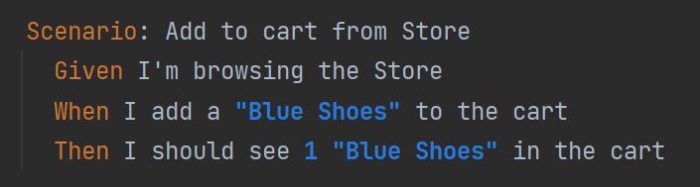
What is BDD?
Ubiquitous language

Slide 24
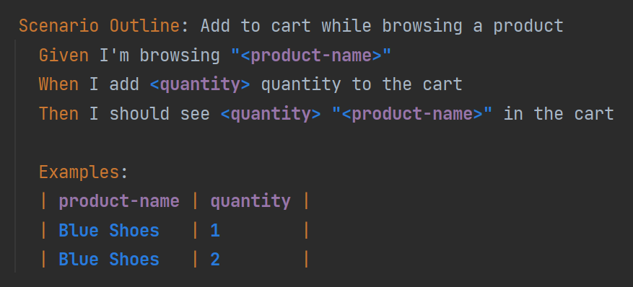
What is BDD?
Concrete, real-world examples

Slide 25
What is BDD?
Acceptance Criteria
Acceptance
Criteria

Slide 26
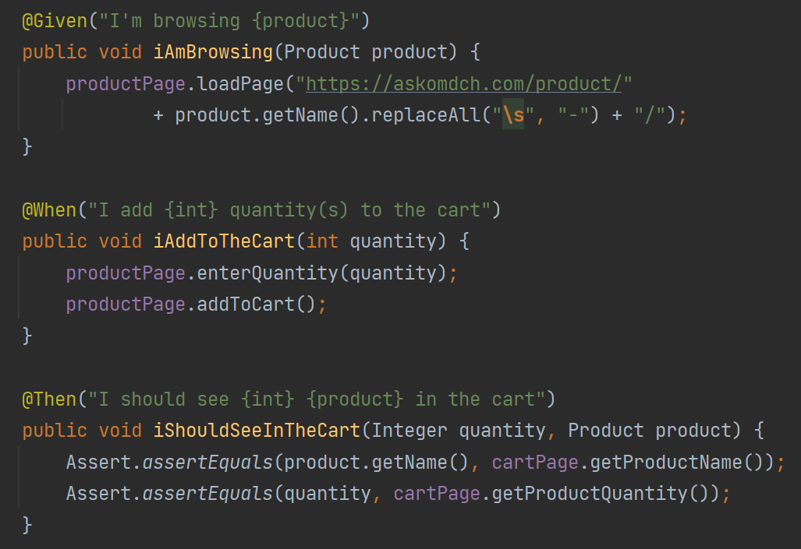
What is BDD?
Executable specifications

Slide 27
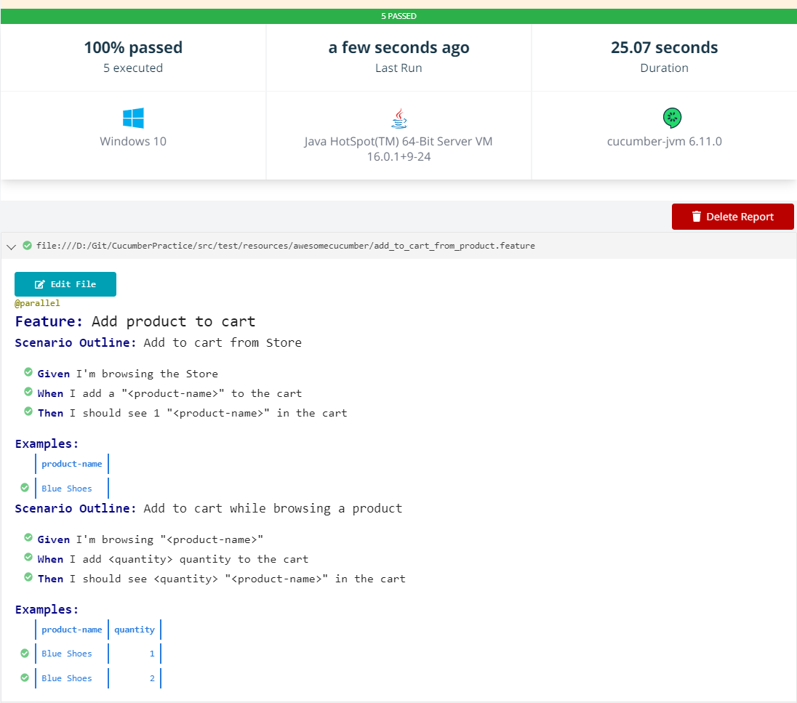
What is BDD?
Living Documentation

Slide 28
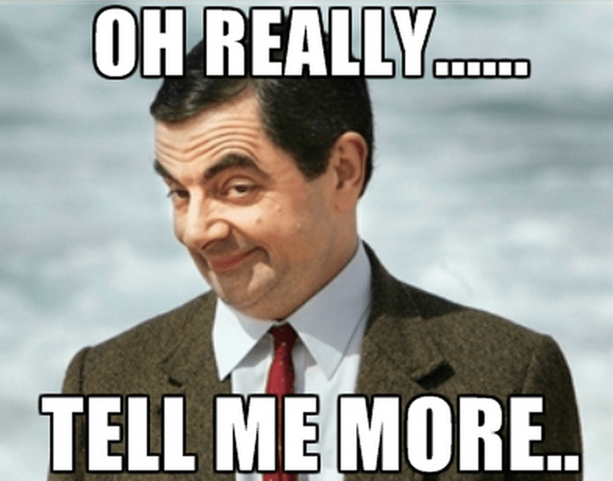
What is BDD?
It’s all about conversations

Slide 29

BDD, TDD and Agile
Can BDD and TDD happen together
When to start BDD
When to start TDD

Slide 30
BDD, TDD and Agile
Formulate
Code
Discover
Write a failing
scenario
BDD
Write a failing
Unit test
User Story
Test
Code
Refactor
TDD

Slide 31
BDD, TDD and Agile
Day 1
Day n …
Analyze
Plan
Analyze
Plan
Analyze
Plan
Formulate
Code
Discover
Formulate
Code
Discover
Formulate
Code
Discover
BDD
BDD
BDD
Test
Code
Refactor
Test
Code
Refactor
Test
Code
Refactor
TDD
TDD
TDD
Deploy
Deploy
Deploy
User story 1
User story 2
User story n …

Slide 32
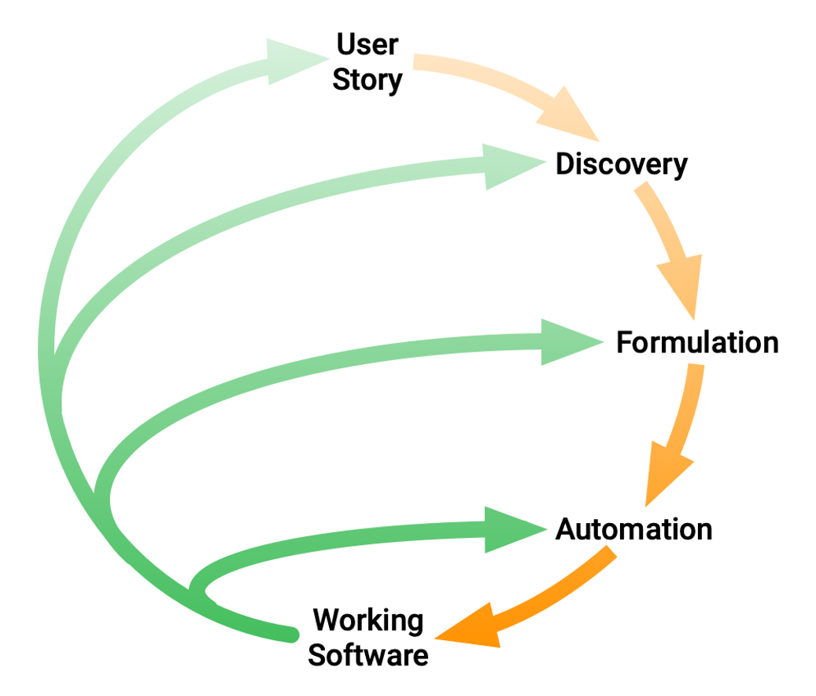
BDD Practices

Slide 33
Discovery workshop
When should you hold a discovery workshop?
Who should attend?
How long does a discovery workshop take?
How to conduct a discovery workshop?

Slide 34
Example Mapping
User Story

Slide 35
Example Mapping
User Story
Rule
Rule
Rule
Question
Example
Example
Question
Example

Slide 36
Example Mapping
Thumb rules:
Story with too many questions
Story with too many rules
Rule with too many examples
Rule with no example
Story that cannot be scoped in one session
Avoid Gherkins

Slide 37
Example Mapping
Quoting Matt Wynne:
The real benefit of example mapping is to be able to focus on the smallest pieces of behavior inside your story, find the core of the behavior you want and defer the rest until later. With this level of scrutiny, example mapping acts like a filter, preventing big fat stories from getting into your sprint and exploding with last minute surprises three days before demo-day.

Slide 38
BDD Myths
Using Cucumber means you are doing BDD
Discovery workshops are not needed to do BDD
The business should write the Gherkin
Converting manual tests to scenarios means you’re doing BDD
You can automate scenarios after the code is implemented

Slide 39
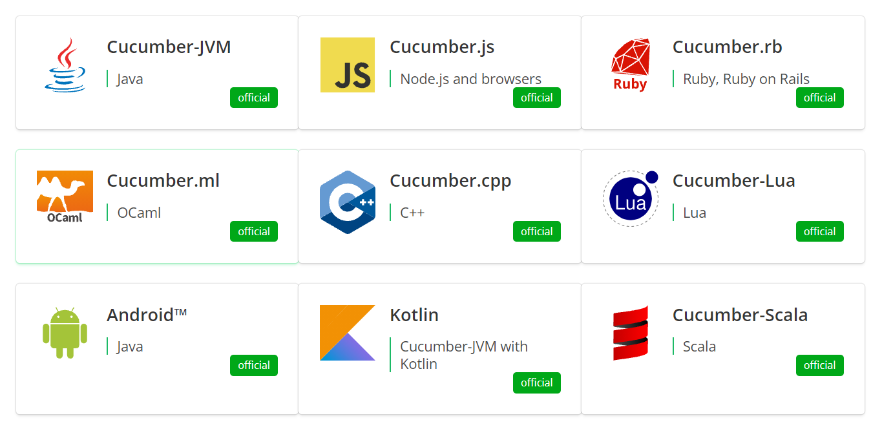
Installation

Slide 40
Installation
Java JDK [17 LTS]
IDE [IntelliJ/Eclipse]
Plugins

